Slide 1
Account Services Management (ASM)

Slide 2
Schedule
Topics Focused On:
ASM Control Records
Online Screens
Batch Flow
Important files
Interfaces to ASM

Slide 3

Background and Introduction to ASM

Slide 4
Background and Introduction to ASM
As the name suggests, We use ASM for Account Services Management.
Account Services Management System (ASM) is an online, real-time software product that enhances customer service functioning.
ASM can access two types of data:
CMS Account Data
Customer Service Representative Data
ASM displays, online, information required to work though a customer call.
ASM supports daily batch processing for customer representative’s transactions and requests.

Slide 5
Background and Introduction to ASM
ASM is required to:
Improve customer service efficiency
Automate follow-up with work queues
Track contact work history

Slide 6
Background and Introduction to ASM
The following is the business perspective of ASM sub-system:
Customer service performance level reporting for management
Catering to Customer complaints and queries
Allowing processor/supervisor to define security parameters for different customer representatives

Slide 7
Background and Introduction to ASM
ASM interfaces with other sub-systems of Vision PLUS and performs the following:
Daily monetary transactions generated by Customer Representatives sent to CMS
Formats Letter requests for CTA or LTS.
Sends Statement reprint requests for CMS.
Updates CMS data via action codes.
Security levels set in Security Subsystem determine the access authority to CMS account data by a customer representative.

Slide 8
ASM Concepts & Terminology

Slide 9
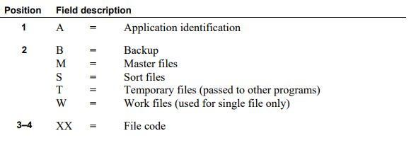
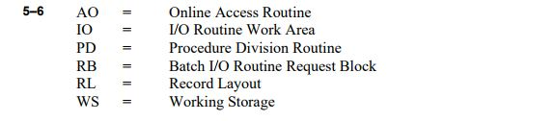
ASM Concepts & Terminology
Naming conventions followed in ASM:-
File copybooks:

Slide 10
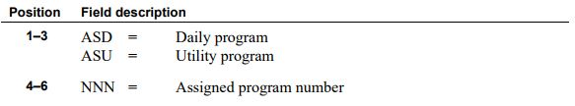
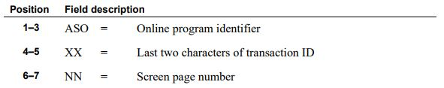
ASM Concepts & Terminology
Batch Programs:-
Examples:- ASD080, ASU020, ASU060, ASD140
Online Programs:-
Examples: ASOMA01 (Action Code Add/Maintenance/Delete/Inquiry Screen 1)
ASOMR00 (Representative Add/Maintenance/Delete Locate Screen)

Slide 11

ASM Concepts & Terminology
Online Maps:-
Names for CICS maps generally contains the transaction name followed by screen number as below:
For example:
Map name of Representative Add/Maintenance/Delete Screen 1, is ASMR01.
Map name of Action Code Add/Maintenance/Delete/Inquiry Locate Screen is ASMA00.

Slide 12
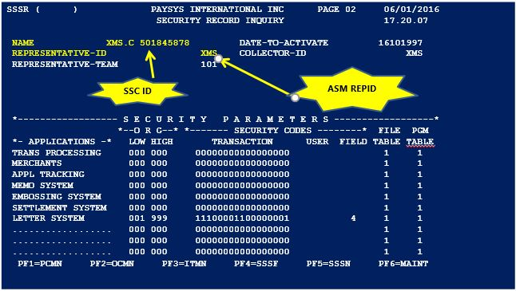
ASM-SSC Link
ASM Rep ID is assigned when the security record of the representative is created.

Slide 13
Customer Representatives Records

Slide 14
Customer Representative Records
Purpose of ASM Representative record
Contains Information about the representative’s
Referral representatives
Amount limits for various types of transactions
Contact details
Access authority to CMS organizations and logos
Memo purge access
Action groups allocated
Tracks Queue tallies for the representative.
Representative have security levels (1- 4).
Security level of 1 is highest with authority to add/modify/delete another representative record and 4 being the least level of access.

Slide 15
Customer Representative Records
Adding/Maintaining Representative Records
ASMR ( ) XX MONEY XXXXXLIA V+ XCICS PAGE 01 11/12/2015 CUSTOMER REPRESENTATIVE 20:14:08 REPRESENTATIVE ID XMS STATUS A DATE ADDED 21/06/10 LAST MAINT 11/12/15 BY XMS REPRESENTATIVE NAME ( MANNY SALUJA ) EFFECTIVE DATE ( 21062010 ) EXPIRATION DATE ( 31122049 ) LEVEL NUMBER 4 REFERRAL REP ( 7RB ) 1ST ALTERNATE ( ) 2ND ALTERNATE ( ) REPRESENTATIVE ADDS Y MAINT Y DELETE Y ACTION CODE ADDS Y MAINT Y DELETE Y POINTS 999999999 DEBITS 000000050 ADVANCE CHECK 999999999 CREDITS 000000050 CR BAL REFUND 000000050 PHONE ( 000 0000000 ) EXT ( 0000 ) HOME PHONE ( 000 0000000 ) OTH ( 000 0000000 ) REPS ORGS: LIST/RANGE ( R ) L/R INCLUDE/EXCLUDE ( I ) I/E ( 001 ) ( 999 ) ( 000 ) ( 000 ) ( 000 ) ( 000 ) ( 000 ) ( 000 ) ( 000 ) ( 000 ) ( 000 ) ( 000 ) ( 000 ) ( 000 ) ( 000 ) ( 000 ) ( 000 ) ( 000 ) ( 000 ) ( 000 )

Slide 16
Action Code Records

Slide 17
Action Code Records
Purpose of Action Codes
To initiate the task related to customer request
To provide different types of action codes for non-monetary, monetary, and other types of requests.
Types of Action Codes
Monetary
Nonmonetary
Transcript
Inquiry
Point
System-generated

Slide 18
Monetary Action Code
ASQA ( ) XX SYSTEM XXXLIA V+ XCICS PAGE 01 09/12/2015 ACTION CODES 18:00:46 MONETARY TRANSACTIONS LAST MAINT 00/00/0000 BY STATUS O ACTION CODE SBWO DESCRIPTION SMALL BALANCE W/OFF MONETARY TRAN CODE 194 DESCRIPTION BALANCE CREDIT ADJUSTMENT EFFECTIVE DATE O R/O TRANSACTION AMOUNT R R/O STORE NUMBER R R/O DEPARTMENT NUMBER O R/O SKU NUMBER O R/O AUTHORIZATION NUMBER O R/O PLAN NUMBER R R/O PLAN SEQ NUMBER O R/O SALES CLERK O R/O TICKET NUMBER O R/O CARD NUMBER R/O CARD SEQ# R/O P/O NUMBER R/O R/REF NUMBER R/O DEFAULT LETTER RETENTION 458 0-999 ASSOCIATED TRANSACTION PAGE 00 CMS TRANSACTION ID ELIGIBLE ACCOUNT REPRESENTATIVES (OPTIONAL)

Slide 19
Action Code Records
Monetary Action Codes
Monetary transactions on account. Examples like Finance charge rebates, Credit Balance refunds and corrections for misapplied purchases, payments or fees.
ASM generates batch transactions to be processed by CMS

Slide 20
Action Code Records
Non-Monetary Action Code
ASQA ( ) XX XXXEY XXXXXXLIA V+ XCICS PAGE 02 09/12/2015 ACTION CODES 18:02:18 NON-MONETARY TRANSACTIONS LAST MAINT 00/00/0000 BY STATUS O ACTION CODE ADDR DESCRIPTION ADDRESS CHANGE RE-QUEUE FACTOR 00 0 - 99 FREQUENCY H M,H,D RETENTION 458 0 - 999 REVIEW DATE/TIME O R/O DEFAULT LETTER CARD NUMBER R/O CARD SEQ# R/O ASSOCIATED TRANSACTION ARM2 PAGE 01 CMS TRANSACTION ID ELIGIBLE ACCOUNT REPRESENTATIVES (OPTIONAL)

Slide 21
Action Code Records
Non-Monetary Action Codes
Account maintenance activity that does not affect financial status of the account. Examples. Address change, reissue of credit cards or placement of block code on an account
Transfers control to the required CMS transaction for updating non-monetary details

Slide 22
Action Code Records
Transcript Request
ASQA ( ) XX XXXEY XXXXXALIA V+ RCICS PAGE 03 09/12/2015 ACTION CODES 18:22:55 TRANSCRIPT REQUEST LAST MAINT 00/00/0000 BY STATUS O ACTION CODE LOOK DESCRIPTION LOOK! IMPORTANT INFO EFFECTIVE DATE O R/O TRANSACTION AMOUNT O R/O STORE NUMBER O R/O DEPARTMENT NUMBER O R/O TICKET NUMBER O R/O REFERENCE NUMBER O R/O CARD NUMBER O R/O CARD SEQ# O R/O P/O NUMBER O R/O R/REF NUMBER O R/O REVIEW DATE/TIME O R/O RE-QUEUE FACTOR 00 0-99 FREQUENCY H M,H,D RETENTION 458 0-999 DEFAULT LETTER ELIGIBLE ACCOUNT REPRESENTATIVES (OPTIONAL)

Slide 23
Action Code Records
Transcript Action Codes
Actions that require the representative to obtain additional information before action is completed. Examples like a copy of sales ticket required.
Always sent to transcript queue to be put on HOLD for research before final processing.

Slide 24
Action Code Records
Inquiry Request
ASQA ( ) XY XYZEY XYZBSLIA V+ XCICS PAGE 01 09/12/2015 ACTION CODES 18:30:27 INQUIRY REQUEST LAST MAINT 00/00/0000 BY STATUS O ACTION CODE BALI DESCRIPTION BALANCE INQUIRY RETENTION 090 0-999

Slide 25
Action Code Records
Inquiry Action Codes
Tracking activity on an account resulting from customer calls. Examples include Current balance inquiry and Credit limit information.

Slide 26
Action Code Records
Point Transactions
ASMA ( ) USER DEFINED TITLE PAGE 05 07/05/2004 ACTION CODES 22:27:15 MONETARY TRANSACTIONS LAST MAINT 05/13/2004 BY 001 ROM POINTS STATUS O ACTION CODE DDDD DESCRIPTION ( NEW ) MONETARY TRAN CODE ( 892 ) DESCRIPTION ( FREQUENT SHOPPER POINTS INCREASE ) EFFECTIVE DATE ( O ) R/O DEFAULT LETTER ( 00 ) RETENTION 200 0-999 ELIGIBLE ACCOUNT REPRESENTATIVES (OPTIONAL) ( 0 ) ( 0 ) ( 0 ) ( 0 ) ( 0 ) ( 0 ) ( 0 ) ( 0 ) ( 0 ) ( 0 ) PF1=ASMU PF2=ASMW PF3=ASSD PF4=ASHI PF5=ASTQ PF6=INQUIRY

Slide 27
Action Code Records
Point Action Codes
Used when dealing with loyalty program requests for accounts in CMS (a special type of Monetary Transaction)
e.g. point adjustment, redemption, etc.
Do not affect actual monetary balance
$10 off
next
purchase

Slide 28
Action Code Interfaces
Automatic system actions that are recorded against action code are :
Letter requests ( e.g. – DDRF action code).
Note : The letter request are reported in the AMDS file. Then LTDT is prepared from it & passed to LTS.
Statement reprint requests made by Representatives using the ASM Statement Reprint screen.
Note : The Statement reprint request are reported in the AMDS file. Then ASC1 file is prepared from it & passed to CMS for statement reprint.
External systems can also record significant events on the history file.

Slide 29
Account Works Screen
The Account Work Screen

Slide 30
The Account Work Screen
Account Work Screen for Monetary Actions
ASMW ( ) XX XXXEY AXXXXLXX V+ RCICS PAGE 01 10/12/2015 ACCOUNT WORK 01:35:41 ORG 161 ACCOUNT 000999993600004310 LOGO GO MASTERCARD MS S/TESTSTAFFROLLBACKONE DOB 03091983 00000000 CASH RETAIL 572 SWAN ST CURR BAL .00 .00 RICHMOND VIC3121 CR LIMIT 0 10,000 HOME PHONE 000 0000000 O-T-B 0 8,020 WORK PHONE 000 0000000 MEMO BAL .00 1,980.00 CASE NBR 00000000000 BC 1 Z BC 2 COLL 00 00/00/0000 RM 00 STAT N XMS DATE 10/12/2015 01:24 ACTION ADDR ADDRESS CHANGE STA C XMS DATE 10/12/2015 01:29 ACTION SBWO SMALL BALANCE W/OFF STA C *S* DATE 10/12/2015 01:34 ACTION RTDB NEW PLAN DEBIT STA R ACTION SBWO HOLD/PROCESS/REFER P H/P/R REP NOTE ( ) ( ) ( ) EFF DATE 15102015 AMT ( ) PLAN ( 00000 ) PS 00 DEPT AUTH STORE ( 000000000 ) SKU 000000000 CLERK APPR/DECL A LTR LTR ORG 161 CARD# 0005218933600004310 CARD SEQ# 0001 TKT# 000000000000000 P/O# R/REF# 00000000000000 PMT S ( ) MEDIA ( 00 ) AMOUNT MUST BE NUMERIC

Slide 31
The Account Work Screen
Account Work Screen for Non-Monetary Actions
ASMW ( ) USER DEFINED SYSTEM TITLE PAGE 03 07/01/2004 ACCOUNT WORK 23:20:00 CMS ORG 001 ACCOUNT 0000004122835024884 LOGO VISA GOLD KABABIK,KIMBERLY HOME PHONE 9082319116 142 RIVER RD WORK PHONE 4444444444 SOMERVILLE NJ 08876-3622 CASE # 00000000000 CURR BAL C/R 0.00 0.00 COLL 05 07/17/1999 CR LIMIT C/R 3 3 RM 00 STAT F O-T-B C/T 0 0 BC 1 M BC 2 A MEMO BAL C/R 0.00 0.00 VIP 0 001 OGH DATE 05/26/2004 01:16 ACTION STA C 001 OGH DATE 06/25/2004 04:29 ACTION STA C 001 RAS DATE 07/01/2004 06:19 ACTION ARIQ JUST INQUIRY BOSS STA C ACTION ADDR HOLD/PROCESS/REFER P H/P/R REP NOTE ( ) ( ) ( ) R-DATE R-TIME LTR ST L-ORG CARD NUMBER CARD SEQ# ( 00000000 ) ( 0000 ) ( 00 ) ( 000 ) ( 0000004122835024884 ) ( 0001 ) CURRENCY 840 NOD 2 PER ITEM NOD 2 PERCENTAGE NOD 7 PF1=ASMU PF2=RESERVED PF3=ASSD PF4=ASSQ PF5=ASTQ PF6=ASHI

Slide 32
The Account Work Screen
Account Work Screen for Inquiry Actions
ASMW ( ) XX XXXXX XXXXXLIA V+ XCICS PAGE 01 10/12/2015 ACCOUNT WORK 01:40:26 ORG 161 ACCOUNT 0005218933600004310 LOGO GO MASTERCARD MS S/TESTSTAFFROLLBACKONE DOB 03091983 00000000 CASH RETAIL 572 SWAN ST CURR BAL .00 .00 RICHMOND VIC3121 CR LIM 0 10,000 HOME PHONE 000 0000000 O-T-B 0 8,020 WORK PHONE 000 0000000 MEMO BAL .00 1,980.00 CASE NBR ( ) BC 1 Z BC 2 CL CDE COLL 00 00/00/0000 RM 00 STAT N PASSWORD PASSWORD XMS DATE 10/12/2015 01:29 ACTION SBWO SMALL BALANCE W/OFF STA C *S* DATE 10/12/2015 01:34 ACTION RTDB NEW PLAN DEBIT STA R XMS DATE 10/12/2015 01:37 ACTION LOOK LOOK! IMPORTANT INFO STA C ACTION ( BALI ) HOLD/PROCESS/REFER ( ) H/P/R REP ( ) NOTE ( ) ( ) ( )

Slide 33
The Account Work Screen
Account Work Screen for Transcript Actions
ASMW ( ) XX XXXXX XXXXXXLXX V+ XCICS PAGE 01 10/12/2015 ACCOUNT WORK 01:38:16 ORG 161 ACCOUNT 0005218933600004310 LOGO GO MASTERCARD MS S/TESTSTAFFROLLBACKONE DOB 03091983 00000000 CASH RETAIL 572 SWAN ST CURR BAL .00 .00 RICHMOND VIC3121 CR LIMIT 0 10,000 HOME PHONE 000 0000000 O-T-B 0 8,020 WORK PHONE 000 0000000 MEMO BAL .00 1,980.00 CASE NBR 00000000000 BC 1 Z BC 2 COLL 00 00/00/0000 RM 00 STAT N XMS DATE 10/12/2015 01:29 ACTION SBWO SMALL BALANCE W/OFF STA C *S* DATE 10/12/2015 01:34 ACTION RTDB NEW PLAN DEBIT STA R XMS DATE 10/12/2015 01:37 ACTION LOOK LOOK! IMPORTANT INFO STA C ACTION LOOK HOLD/PROCESS/REFER P H/P/R REP NOTE ( ) ( ) ( ) DATE ( 00000000 ) AMT ( ) STORE ( 000000000 ) DEPT ( ) TKT ( ) REF NBR ( ) R-DATE ( 00000000 ) R-TIME ( 0000 ) LTR ( ) LTR ORG ( 161 ) CARD NUMBER ( 0005218933600004310 ) CARD SEQ # ( 0001 ) P/O# ( ) R/REF# ( 00000000000000 )

Slide 34
The Account Work Screen
Code that controls what the system should do with an ACTION.
H – Hold action
P or blank – Process action
R – Refer action
ASMW ( ) XX USER DEFINED V+ XCICS PAGE 01 10/12/2015 ACCOUNT WORK 01:29:52 ORG 161 ACCOUNT 0005218933600004310 LOGO GO MASTERCARD MS S/TESTSTAFFROLLBACKONE DOB 03091983 00000000 CASH RETAIL 572 SWAN ST CURR BAL .00 .00 RICHMOND VIC3121 CR LIM 0 10,000 HOME PHONE 000 0000000 O-T-B 0 8,020 WORK PHONE 000 0000000 MEMO BAL .00 1,980.00 CASE NBR ( ) BC 1 Z BC 2 CL CDE COLL 00 00/00/0000 RM 00 STAT N PASSWORD PASSWORD XMS DATE 10/12/2015 01:24 ACTION ADDR ADDRESS CHANGE STA O XMS DATE 10/12/2015 01:24 ACTION ADDR ADDRESS CHANGE STA C XMS DATE 10/12/2015 01:29 ACTION SBWO SMALL BALANCE W/OFF STA C ACTION ( ADDR ) HOLD/PROCESS/REFER ( H ) H/P/R REP ( ) NOTE ( ) ( ) ( )

Slide 35
History

Slide 36
History
Account History Maintenance
Details of any action performed by customer representatives on an account are maintained in a history file
Provision to delete History memos generated for accounts/relationship accounts through online.

Slide 37
Contact History
Contact History Screen
ASHI ( ) USER DEFINED SCREEN NAME PAGE 01 07/01/2016 CONTACT HISTORY 17:28:46 ORG 126 ACCOUNT 000XXXXXXXXXXXXXXXXXX LOGO PRODUCT NAME COOK RACHEL CURR BAL 5209.36 O-T-B 1899 MEMO BAL 5451.09 SVC 04/12/2015 16:03 C SCLH CLIM-INELIGIBLE REVIEW=00/00/0000 00:00 LTR= LTRO=125 CARD#= CARD SEQ#= 1 OSC CLI INELIGIBLE TO APPLY ZF1 04/09/2015 12:19 C MISC MISCELLANEOUS REVIEW=00/00/0000 00:00 LTR= LTRO=000 CARD#= CARD SEQ#= 1 ***Falcon all clear i/c 564***ic sw pch call from same mp# a s in app, veri cip & conf 3xappr $2016.00 @ ATM & Coles (s,d /au) & 1xdecl (with lmt) @ ATM (s/au) from 3/9 10:59am+ skx3 ZF1 04/09/2015 12:09 C MISC MISCELLANEOUS REVIEW=00/00/0000 00:00 LTR= LTRO=000 CARD#= CARD SEQ#= 1 ADEPTRA-Result:ERROR - Calling Window Expired ZF1 04/09/2015 12:09 C MISC MISCELLANEOUS REVIEW=00/00/0000 00:00 LTR= LTRO=000 FIRST PAGE PF1=ASMU PF2=ASMW PF3=*TOP* PF4=ASTQ PF5=*BWD* PF6=*FWD*

Slide 38
Statement History
ASSD – Statement Display
ASSD ( ) USER DEFINED SCREEN NAME PAGE 01 11/12/2015 STATEMENT DISPLAY 22:17:29 ORG 226 ACCOUNT 0005039468414828908 LOGO XX PRODUCT LETTIERI DANUTA MEMO DR 0 .00 CR 0 .00 BAL 625.76 CURRENT 03/12/2015 03/11/2015 03/10/2015 03/09/2015 PURCHASE 0 .00 .00 .00 .00 .00 PAYMENTS 0 .00 50.00 30.00 50.00 50.00 FIN CHGS 0 .00 .31 .13 .00 .03 OTHER DB 0 .00 8.80 28.80 8.95 8.95 OTHER CR 0 .00 .00 .00 .00 .00 RETURNS 0 .00 .00 .00 .00 .00 DISPUTES 0 .00 .00 .00 .00 .00 DISPU REL 0 .00 .00 .00 .00 .00 PAST DUE .00 .00 .00 .00 .00 TOTAL DUE 30.68 30.68 46.41 30.18 30.21 BALANCE 625.76 625.76 666.65 667.72 708.77 ACTION C/P ( ) ( ) ( ) ( ) DATE PMT DUE 24/12/2015 CTA REASON 00 DATE OPEN 07/09/2010 DATE LAST PUR 05/11/2014 COLLECTOR ID NBR PLANS 02 DATE LAST PMT 20/11/2015 DATE IN COLL 00/00/0000 VALID CARDS 01 BLK 1 DATE 21/09/2010 LAST DELINQ 03/01/2015 CR LIMIT 2200 BLK 2 DATE 20/09/2010 LAST REAGE 00/00/0000 LAST CR LMT 20/09/2010 CARD EXPIRE 07/2017 RECENCY 0 CYC DUE 1 PR YR FC 4.23

Slide 39
Queues, Batches and Tallies

Slide 40
Queues, Batches and Tallies
Representative Work Queues
Pending Queue
Contains actions that were placed on HOLD on Account Work screen(ASMW) or re-queued
Referral Queue
Contains actions that were initiated by another representative and referred to you.
Referrals can be
Direct i.e. referred by user directly
Indirect i.e. system referred due to limits on representative transaction approval limits or on action code
Transcript Queue
Contains actions that require more information before being processed

Slide 41
Queues, Batches and Tallies
ASSQ Screen – Three Queues P,R,T
ASSQ ( ) XX USER DEFINED SC NAME PAGE 00 10/12/2015 REPRESENTATIVE QUEUE LOCATE 17:25:53 QUEUE ( P ) P,R,T REPRESENTATIVE ID ( XMS ) STARTING AMOUNT ( ) ACTION CODE ( ) DATE ( ) MMDDYYYY ORG AND ( ) ACCOUNT NUMBER ( ) PF1=ASMU PF2=ASMW PF3=ASHI PF4=ASSD PF5=ASTQ PF6=ASQB
Pending – Monetary & Non-Mon action code if put on HOLD from ASMW goes to pending Q.
Referral – delegated by other reps.
Transcript – Transcript action code if put on HOLD from ASMW goes to Transcript Q.

Slide 42
Queues, Batches and Tallies
ASM Batches
Online Batch Enquiries/Modifications
Batches of transactions for monetary and point action codes that each representative enters.
ASQB ( ) XX USER DEFINED V+ NAME PAGE 00 10/12/2015 MONETARY TRANSACTION LOCATE 16:06:56 ORG ( 161 ) REP ( XMS ) TYPE ( M ) P = POINT TRANSACTIONS M = MONETARY TRANSACTIONS SPACE = ALL TRANSACTIONS PF1=ASMU PF2=ASMW PF3=*TOP* PF4=*BOT* PF5=*BWD* PF6=*FWD*

Slide 43
Queues, Batches and Tallies
ASM Batches
Online Batch Enquiries/Modifications
The status can be changed. If it is changed to “D”, the transaction will not post to the account.
ASQB ( ) XX XXXXX XXXXXXXXX V+ RCICS PAGE 01 10/12/2015 MONETARY TRANSACTIONS 17:24:17 ORG 161 REP XMS MANNY SALUJA SEQ 001 ACCT 0005218933600004310 $ 20.00 TX 194 EFF 09122015 STORE 000000001 PLN 00001 TKT 000000000000000 CRD# 0005218933600004328 0001 SKU DESC BALANCE CREDIT ADJUSTMENT AUTH DEPT SALESCLERK STA D 002 ACCT 0005218933600004310 $ 3.00 TX 194 EFF 15102015 STORE 000000001 PLN 00001 TKT 000000000000000 CRD# 0005218933600004328 0001 SKU DESC BALANCE CREDIT ADJUSTMENT AUTH DEPT SALESCLERK STA ( D ) PF1=ASMU PF2=ASMW PF3=*TOP* PF4=*BOT* PF5=*BWD* PF6=*FWD*

Slide 44
Queues, Batches and Tallies
Queue Tallies
Online view Queue Tallies ( ASTQ Screen)
Use the Queue Tallies screens to view a summary of actions currently in your queues, as well as actions you have completed today, week-to-date, and month-to-date.
You can also use this function to view queue tallies for any representative at your level or below
ASM monitors status of complete and incomplete account actions
Queue Tallies can be viewed either for all CMS organizations or a particular CMS Organization for a representative.
Three types of incomplete actions:
Pending
Transcript
Referral
Updates of Queue Tallies
All tallies, except date of oldest items, are updated once an action is initiated, referred or placed in pending status.

Slide 45
Queues, Batches and Tallies
Queue Tallies – ASTQ Page 0
ASTQ ( ) XX XXXXX XXXXXXX V+ XCICS PAGE 00 08/01/2016 TALLY LOCATE 00:23:50 REP ( XMS ) PF1=ASMU PF2=ASMW PF3=ASSD PF4=ASHI PF5=ASMA PF6=ASMR

Slide 46
Queues, Batches and Tallies
Queue Tallies – ASTQ Page 1
ASTQ ( ) XX XXXXX XXXXXX V+ XCICS PAGE 01 11/12/2015 QUEUE TALLIES 18:07:26 QUEUE STATUS NBR AMOUNT OLDEST IN QUEUE REP PENDING 4 .00 11/11/11 XMS REFERRAL 1 5.00 00/00/00 MANNY SALUJA TRANSCRIPT 1 .00 00/00/00 TOTAL IN QUEUE 6 5.00 TODAY WEEK-TO-DATE MONTH-TO-DATE DESCRIPTION NBR AMOUNT NBR AMOUNT NBR AMOUNT DIRECT HANDLED 3 25.00 12 25.00 12 25.00 DIRECT REFERRED 2 120.00 3 1269.91 3 1269.91 REFRS PROCESSED 0 .00 0 .00 0 .00 REFRS REFERRED 0 .00 1 8989989.89 1 8989989.89 REFRS DELETED 0 .00 0 .00 0 .00 REFRS REVIEWED 0 .00 0 .00 0 .00 HOLDS PROCESSED 1 .00 1 .00 1 .00 HOLDS REFERRED 0 .00 0 .00 0 .00 HOLDS DELETED 0 .00 0 .00 0 .00 HOLDS REVIEWED 0 .00 0 .00 0 .00 TRANSCRIPTS 1 1 1 LETTER REQUESTS 0 0 0 PF1=ASMU PF2=ASMW PF3=ASSD PF4=ASHI PF5=ASMA PF6=ASMR

Slide 47
Queues, Batches and Tallies
Queue Tallies – ASTQ Page 2
ASTQ ( ) XX XXXXX XXXXXXIA V+ XXICS PAGE 02 11/12/2015 ACTION TALLIES 18:12:15 REP XMS MANNY SALUJA TODAY WEEK-TO-DATE MONTH-TO-DATE ACTION DESCRIPTION NBR AMOUNT NBR AMOUNT NBR AMOUNT BALANCE TRANSFE 0 .00 1 .00 1 .00 ADDR ADDRESS CHANGE 1 .00 1 .00 1 .00 BALI BALANCE INQUIRY 0 .00 1 .00 1 .00 BLTR BALANCE TRANSFE 0 .00 4 .00 4 .00 CDCF CONFIRMED DETAI 0 .00 1 .00 1 .00 LOOK LOOK! IMPORTANT 1 .00 1 .00 1 .00 MIAC MIGR ACC ACTIVA 0 .00 2 .00 2 .00 MISC MISCELLANEOUS 0 .00 1 .00 1 .00 SBWO SMALL BALANCE W 3 25.00 3 25.00 3 25.00

Slide 48
Messages
The Message Board

Slide 49
Messages
Sending messages and reading received messages
Messages added by you for a representative can we viewed on his screen
Messages sent by a representative can be modified/viewed only by him
The screen name is ASAM/ASMM/ASQM.

Slide 50
MESSAGE BOARD Screen
ASAM Screen
ASAM ( ) XX XXXXY XXXXXXA V+ XCICS PAGE 02 11/12/2015 MESSAGE BOARD 20:11:01 DATE 11/12/2015 TIME 20:11:01 MESSAGE FROM XMS MESSAGE TITLE ( ) EXPIRATION DATE ( ) ( ) ( ) ( ) ( ) ( ) ( ) ROUTE TO ALL ( N ) Y/N OR ENTER REP ID OR LV1 THRU LV4 FOR LEVEL NUMBERS ( ) ( ) ( ) ( ) ( ) ( ) ( )

Slide 51
Major Online Screens in ASM

Slide 52
Major Online Screens in ASM
ASMU ( ) XX XXXXX XXXXXXLIA V+ XCXCS PAGE 01 11/12/2015 PROCESSING MENU 22:20:05 ( ) <---MAKE SELECTION 1. ASMW - ACCOUNT WORK 2. ASSQ - SEARCH QUEUE 3. ASSD - STATEMENT DISPLAY 4. ASHI - CONTACT HISTORY 5. ASQB - BATCH INQUIRY 6. ASTQ - QUEUE TALLIES 7. ASAM - MESSAGE BOARD ADD 8. ASMM - MESSAGE BOARD MAINT 9. ASQM - MESSAGE BOARD INQ 10. ASRS - ACCOUNT REP STATUS 11. ASAA - ACTION CODE ADD 12. ASMA - ACTION CODE MAINT 13. ASQA - ACTION CODE INQUIRY 14. ASAR - ACCOUNT REP ADD 15. ASMR - ACCOUNT REP MAINT 16. ASQR - ACCOUNT REP INQUIRY 17. ASRQ - ACCOUNT REP ACTION

Slide 53
Batch Processing in ASM

Slide 54
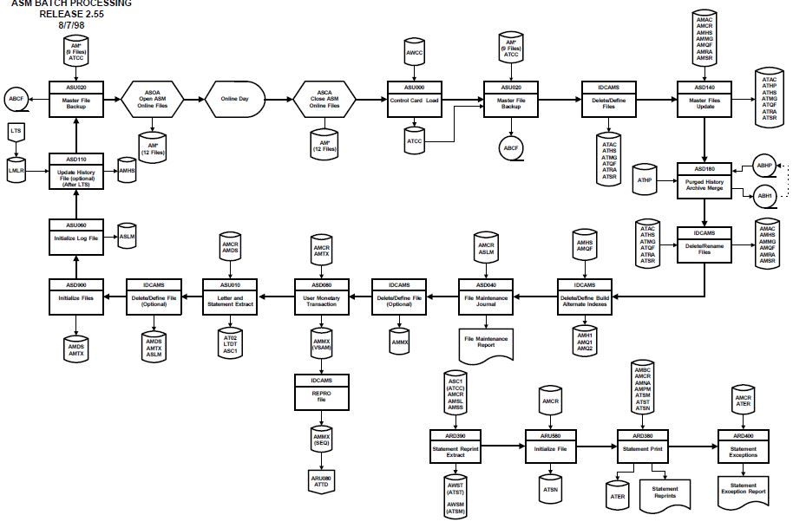
Batch Processing in ASM

Slide 55
Important Files of ASM

Slide 56
Important Files in ASM
Account Service Representative File (AMSR)
Action Code File (AMAC)
Representative Queue File (AMQF)
Messages File (AMMG)
Action History File (AMHS)
Representatives Action Total File (AMRA)
Representative Batch Transaction File (AMTX)
Representatives Statement Reprint and Letter File (AMDS)
ASM Log File (ASLM)

Slide 57
Interfaces to ASM

Slide 58
Internal Interfaces
Letter Request File
Modules
File:LTDT Generated by:ASU010 Used by:LTD040
Letter Request Updates from LTS
Modules
File:LTLP Generated by:LTD200 Used by:ASD110

Slide 59
Internal Interfaces
Letter Requests to CTA
Modules
File:ATO2 Generated by:ASU010 Used by:OCD110
Monetary Transactions to CMS
Modules
File:AMMX Generated by:ASD080 Used by:ARU080

Slide 60
Any Further Information
Want more information?
Confused about anything?

